Slide 1
Colorizing the Prokudin-Gorskii photo collection
CV Project 1

Slide 2
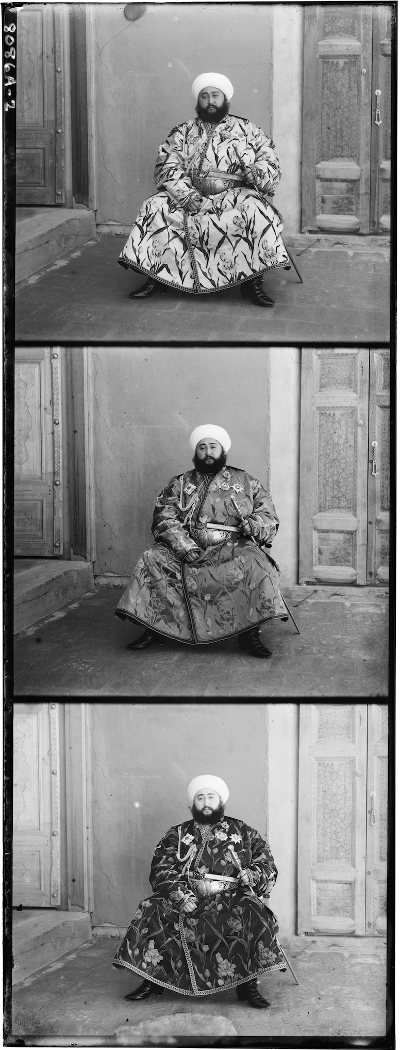
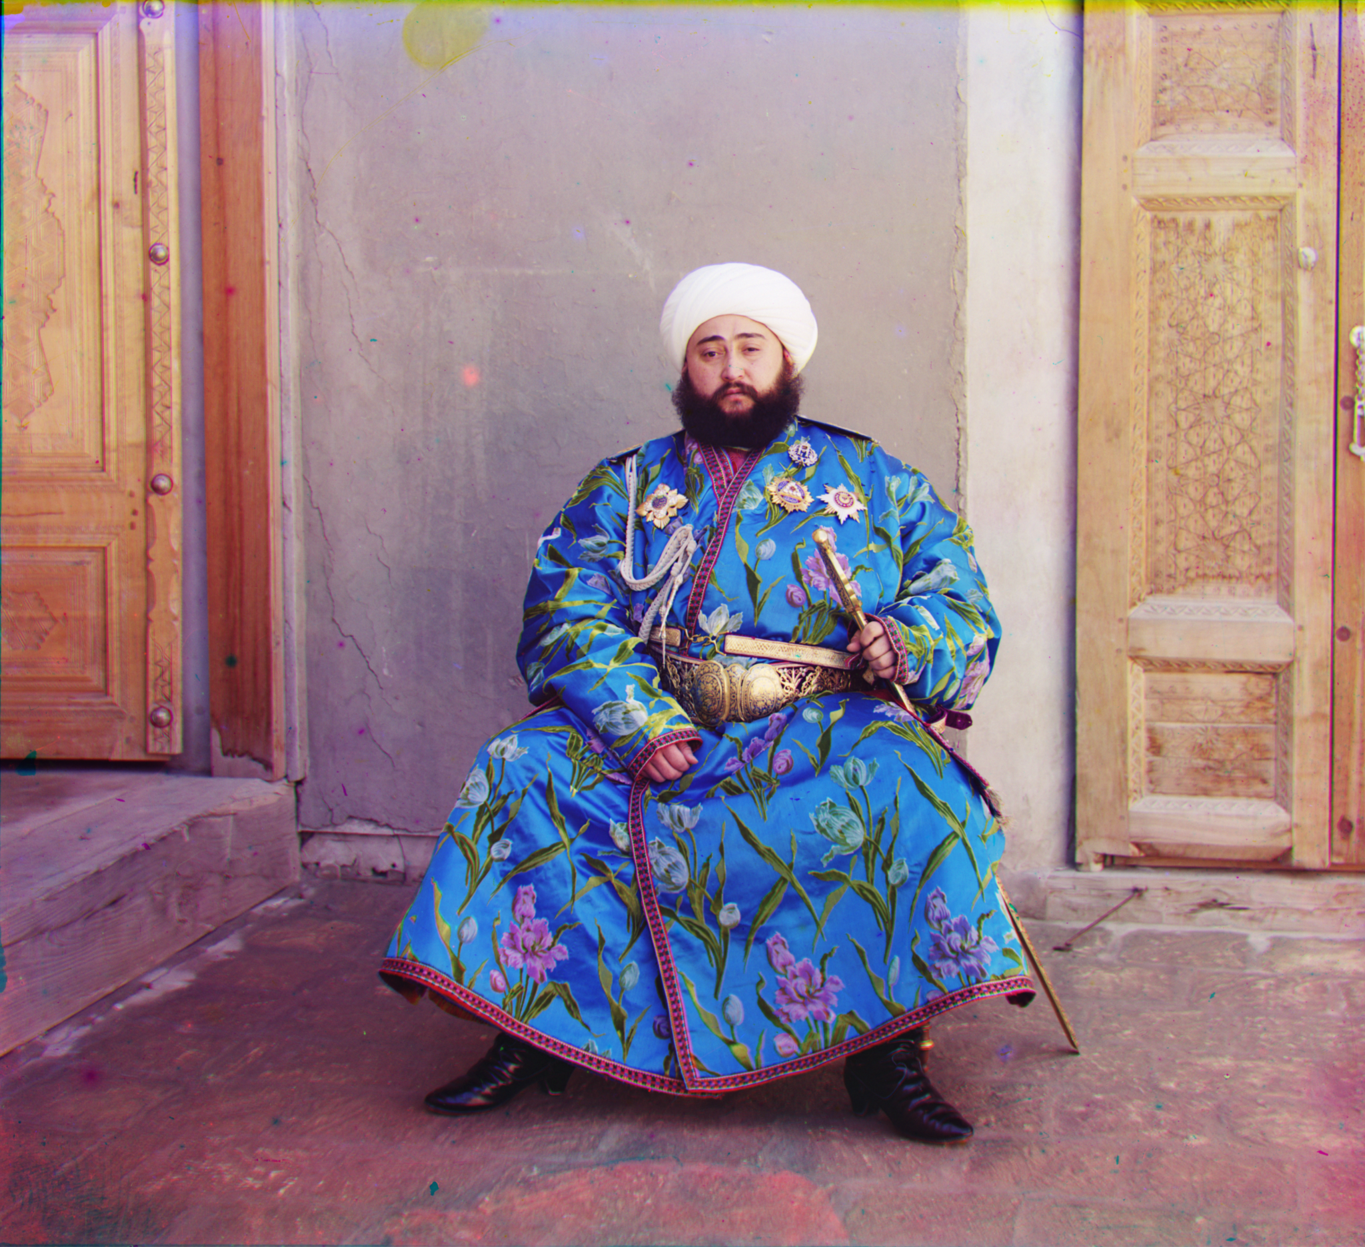

Background

Slide 3

Background

Slide 4

Background

Slide 5
Overview
Divide the original picture into 3 channel.
Align the 3 channels using edge detection and pyramid technique.
Automatically crop the borders of the image.

Slide 6
Divide the picture
B
G
R

Slide 7
B
G
R
np.dstack((R, G, B))

Slide 8
Alignment Process
Img: G, R
Ref: B
Edge detection
Choose search method
Determine the shift range
Use matching metric function to find the best displacement

Slide 9
Edge Detection: Canny
Filter out any noise
Find the intensity gradient of the image
Non-maximum suppression
Double Thresholding
Connect Weak Edge

Slide 10
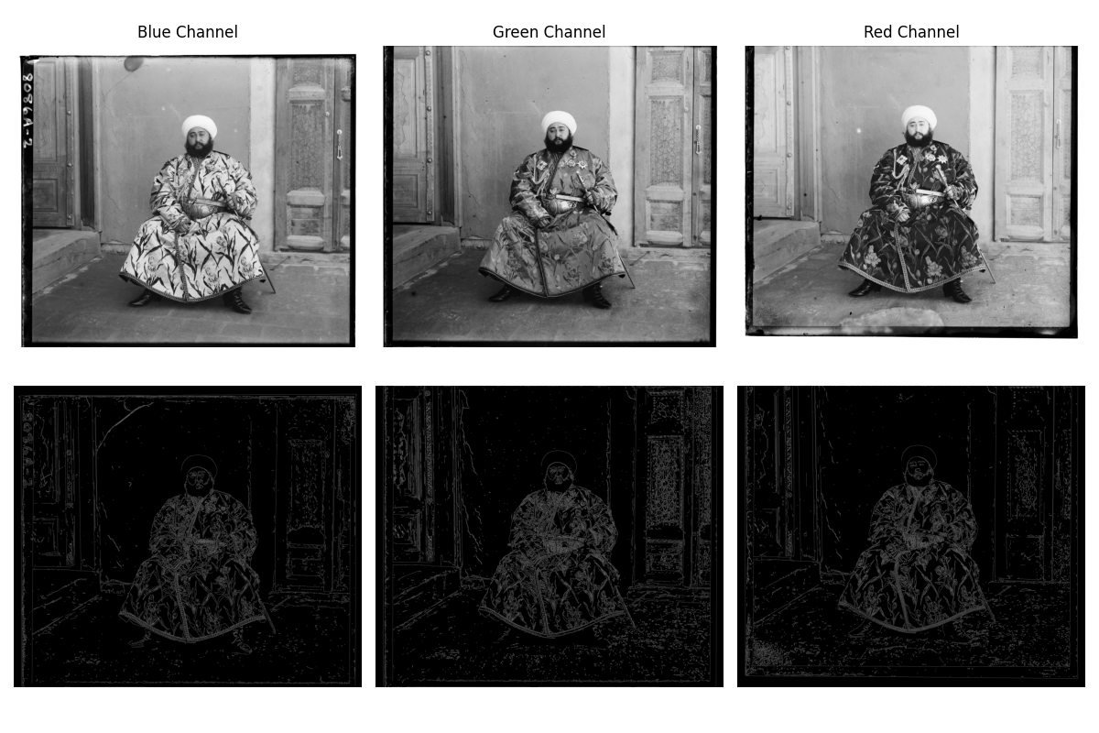

Slide 11
Two Search Method
Exhaustive search
Image Pyramid

Slide 12
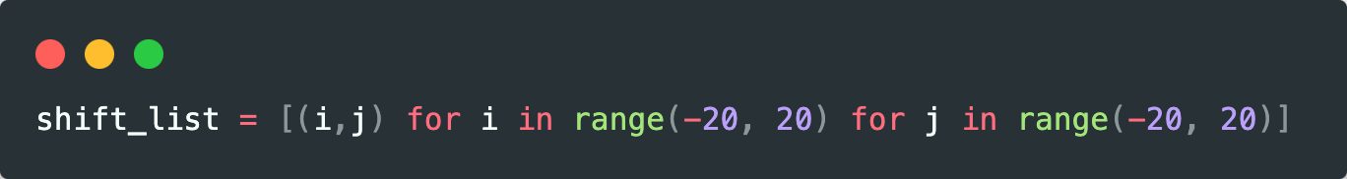
Exhaustive Search
Only search for a small range of displacement
Use for low resolution (<1000) images

Slide 13
Image Pyramid
0.125x
0.25x
0.5x
1x

Slide 14
Image Pyramid
To search for a large range of displacement
Use for high resolution (>1000) images
Faster than exhaustive search

Slide 15
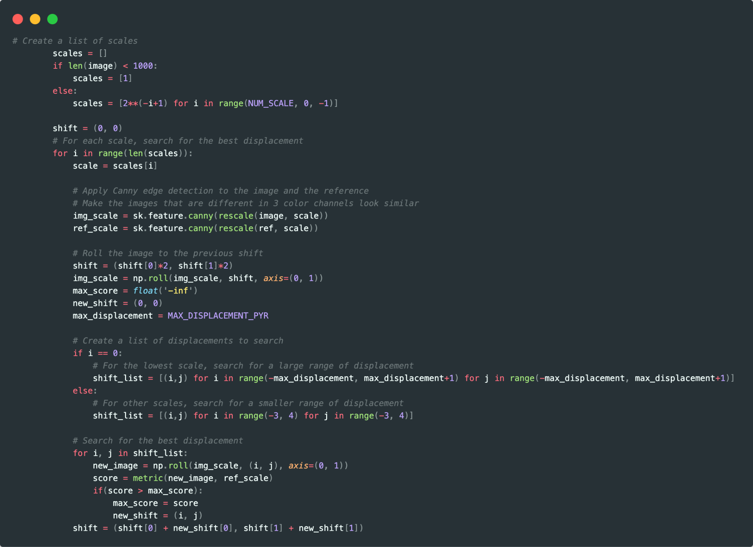

Slide 16
Image matching metric
Sum of Squared Differences (SSD, L2-norm)
Normalized Cross Correlation (NCC)
Structural Similarity (SSID)

Slide 17
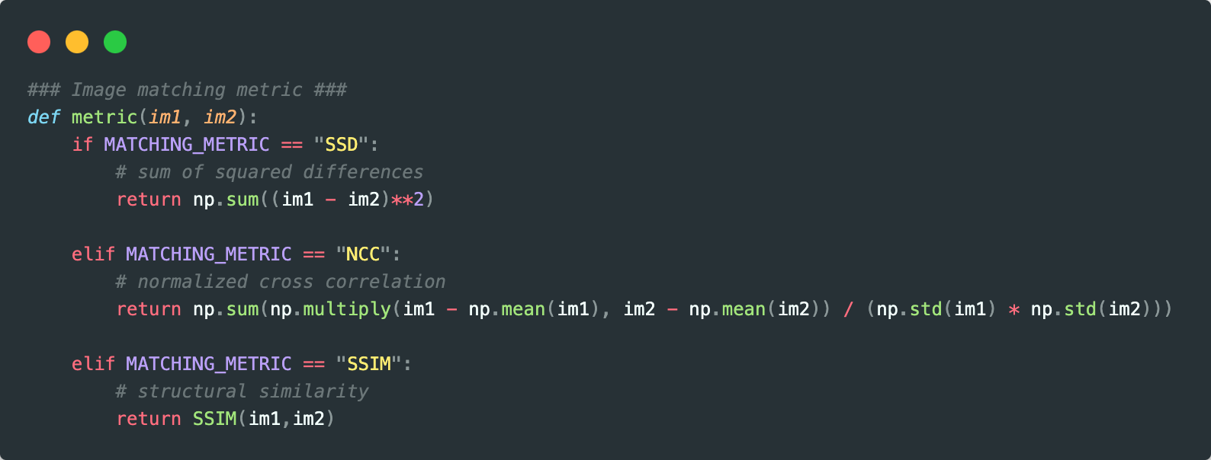
Image matching metric

Slide 18
Auto Crop
Rescale to 0.25x
Apply Gaussian filter to denoise
Edge detection: cv2.Canny
Compute the mean of the rows and columns
Threshold to find edges, then find innermost rows/columns

Slide 19
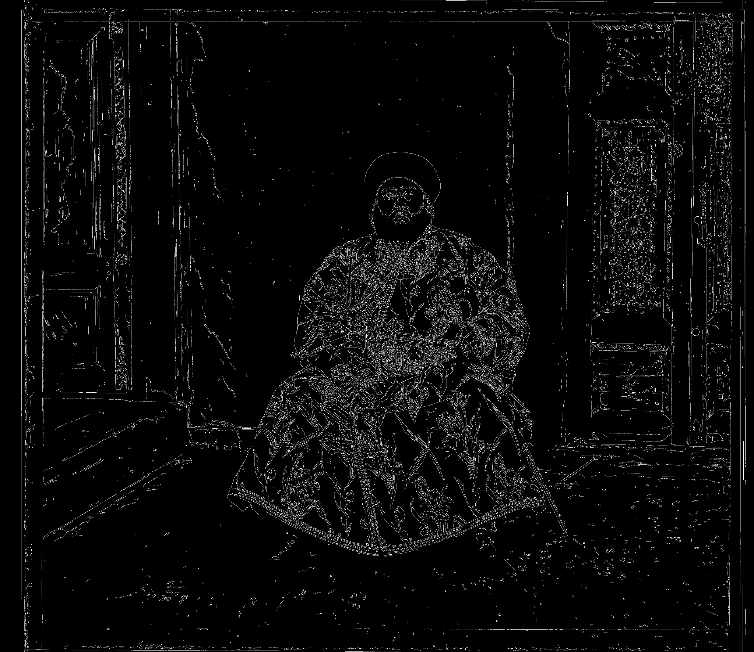
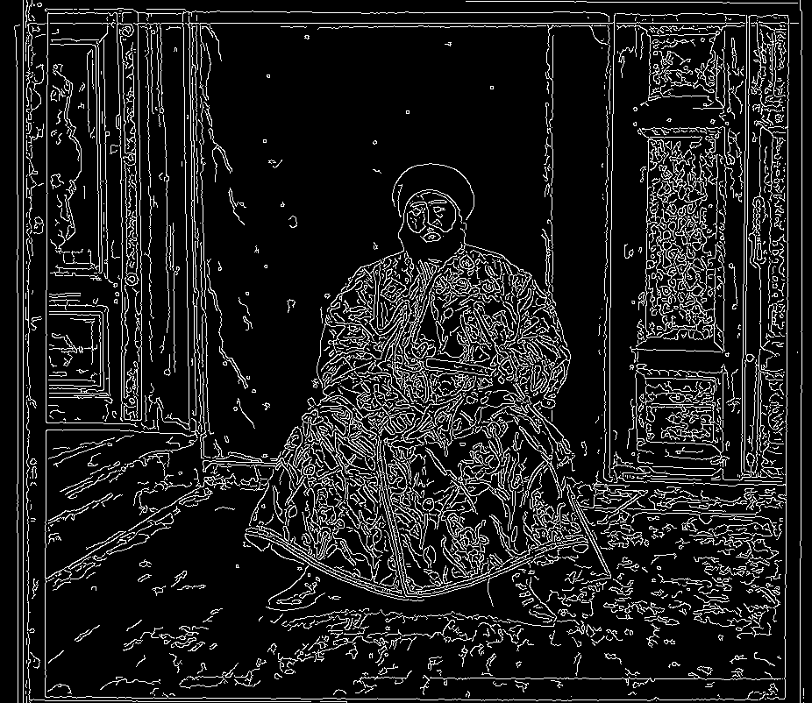
Rescale, Gaussian Blur
1x, Original
0.25x + Gaussian Blur

Slide 20
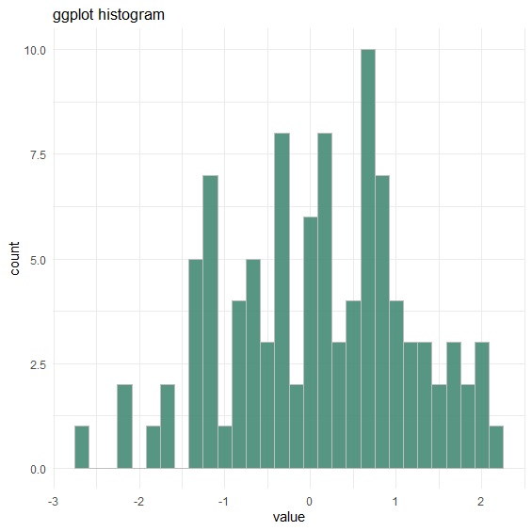
Threshold
Row Mean
Threshold
Column Mean

Slide 21
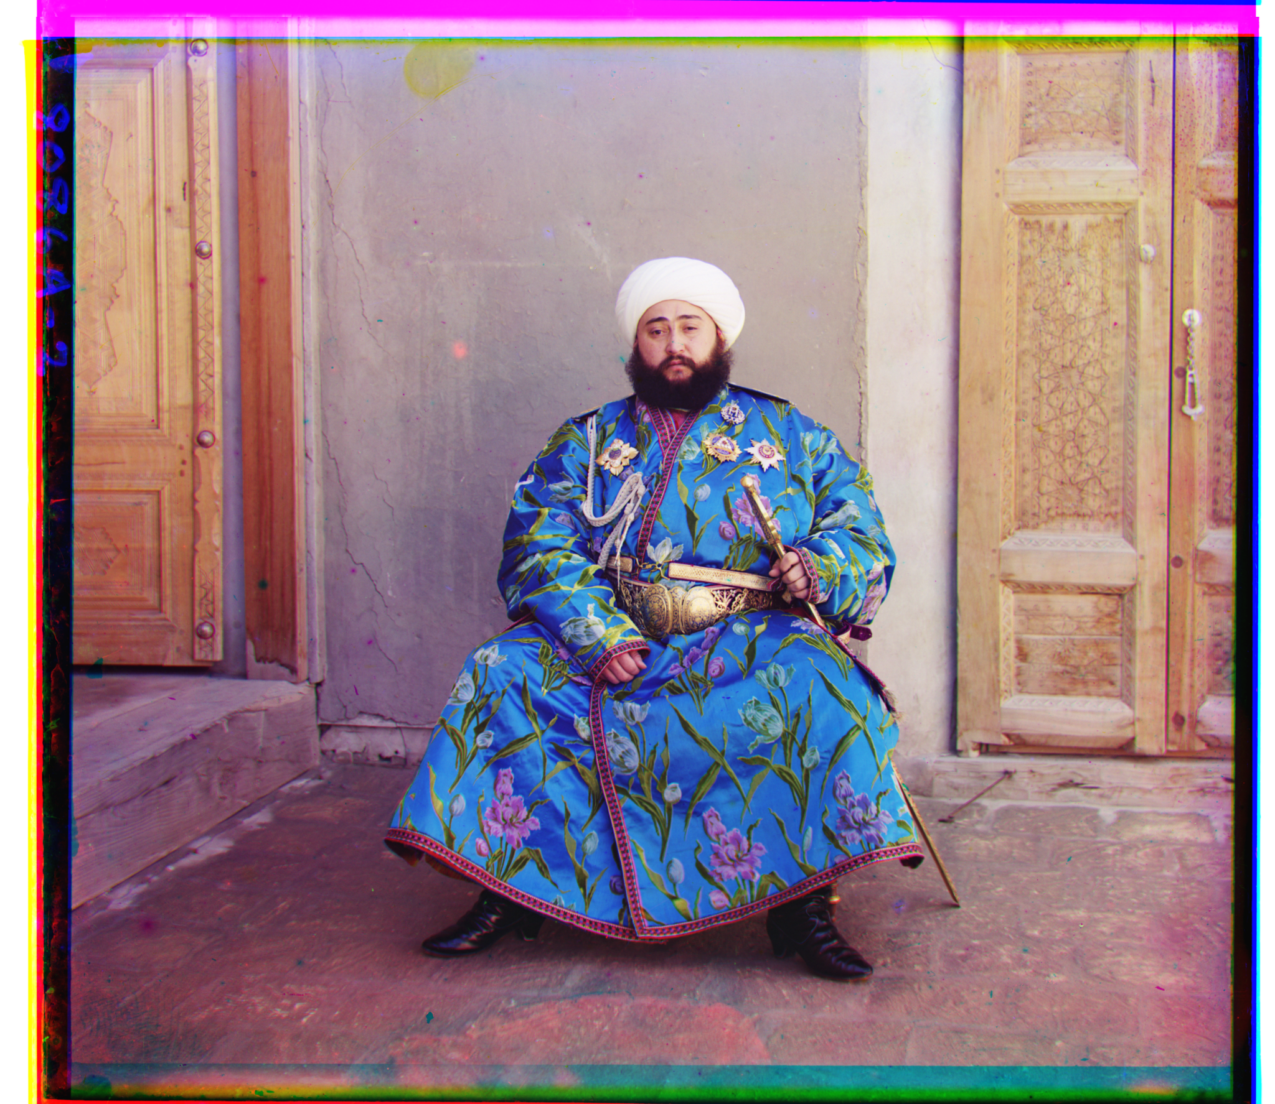
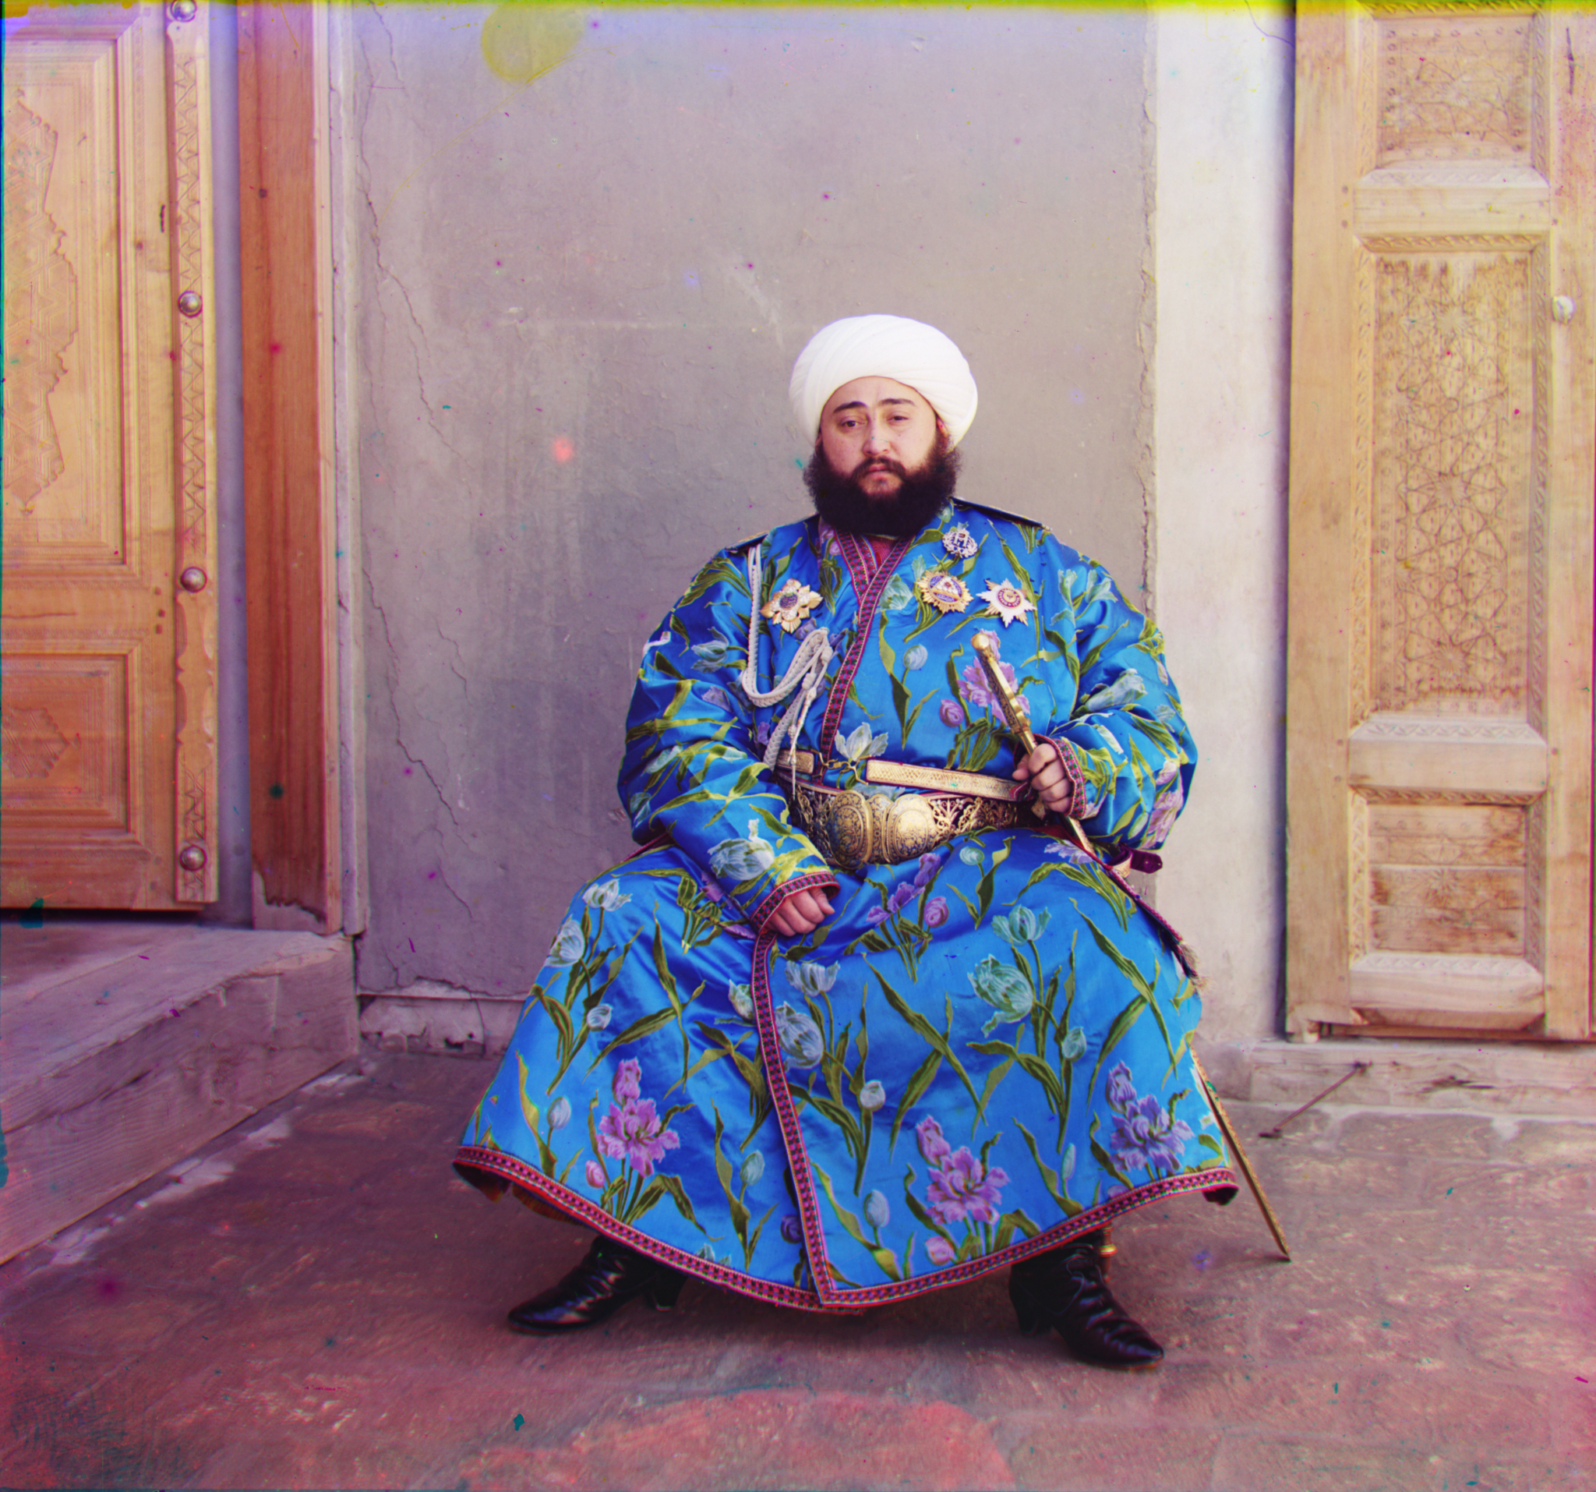
Result

Slide 22
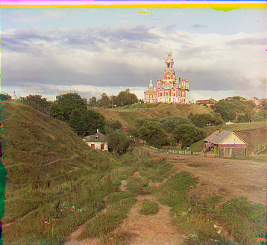
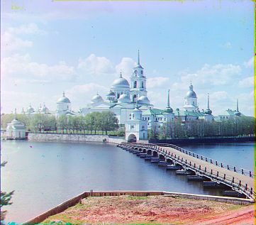
Result

Slide 23
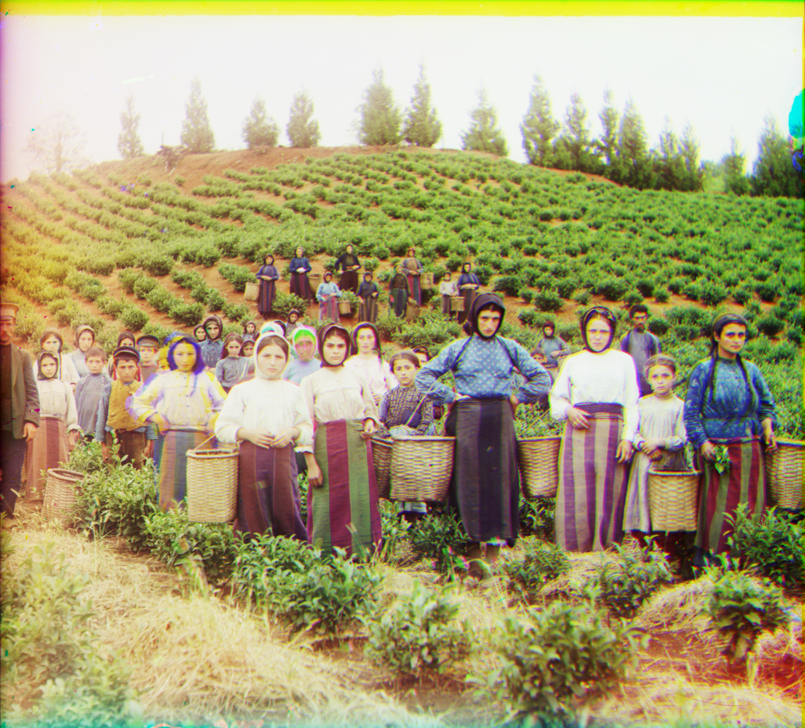
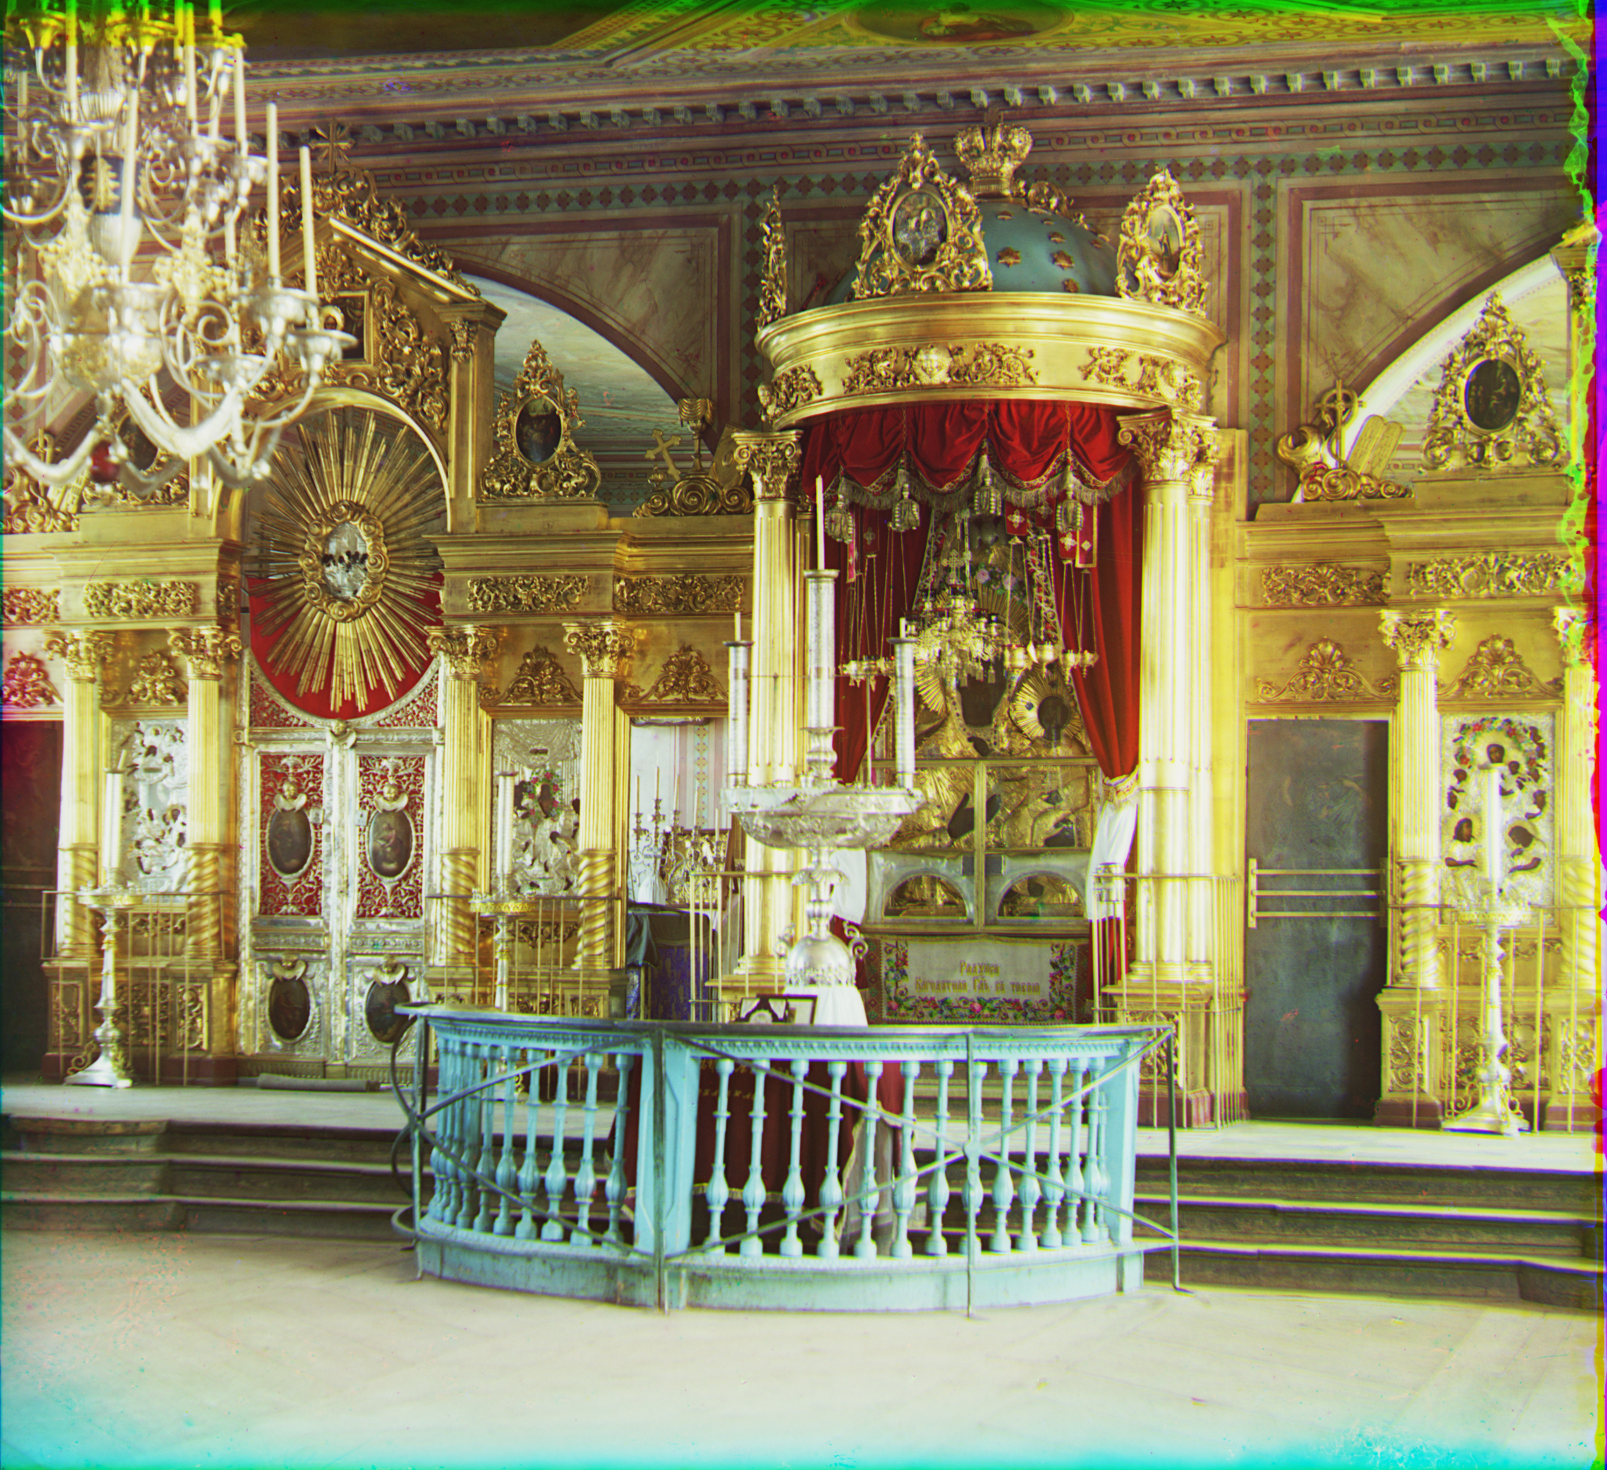
Result

Slide 24
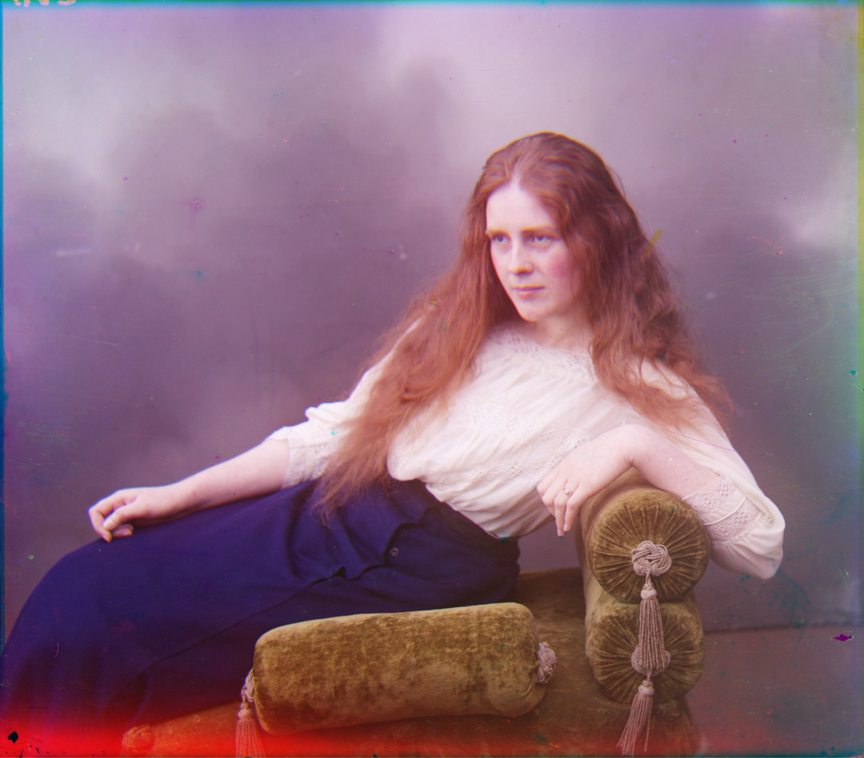
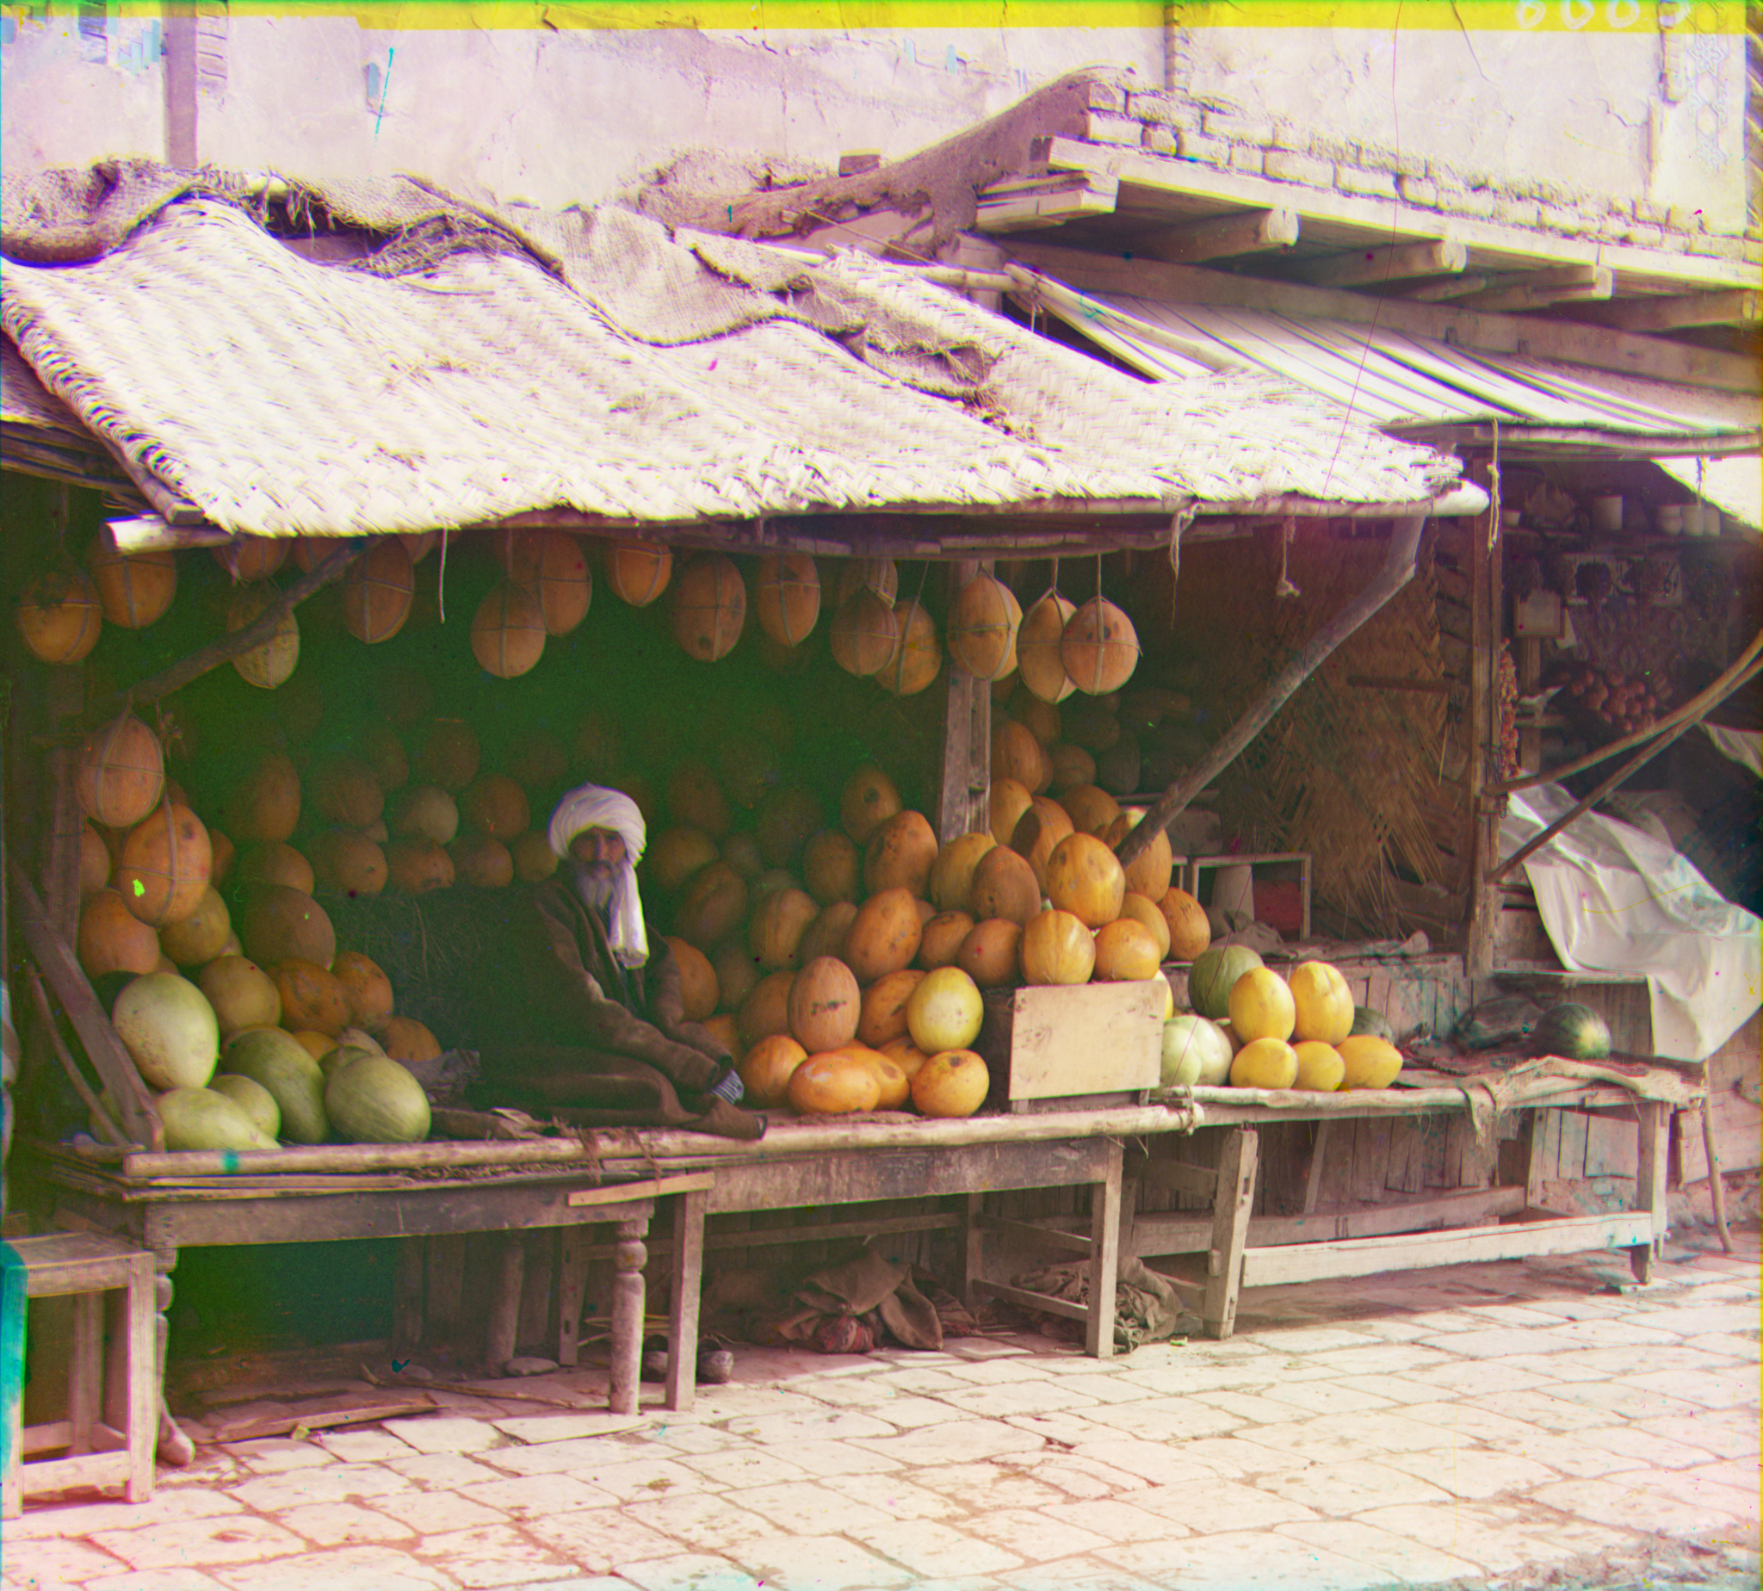
Result

Slide 25
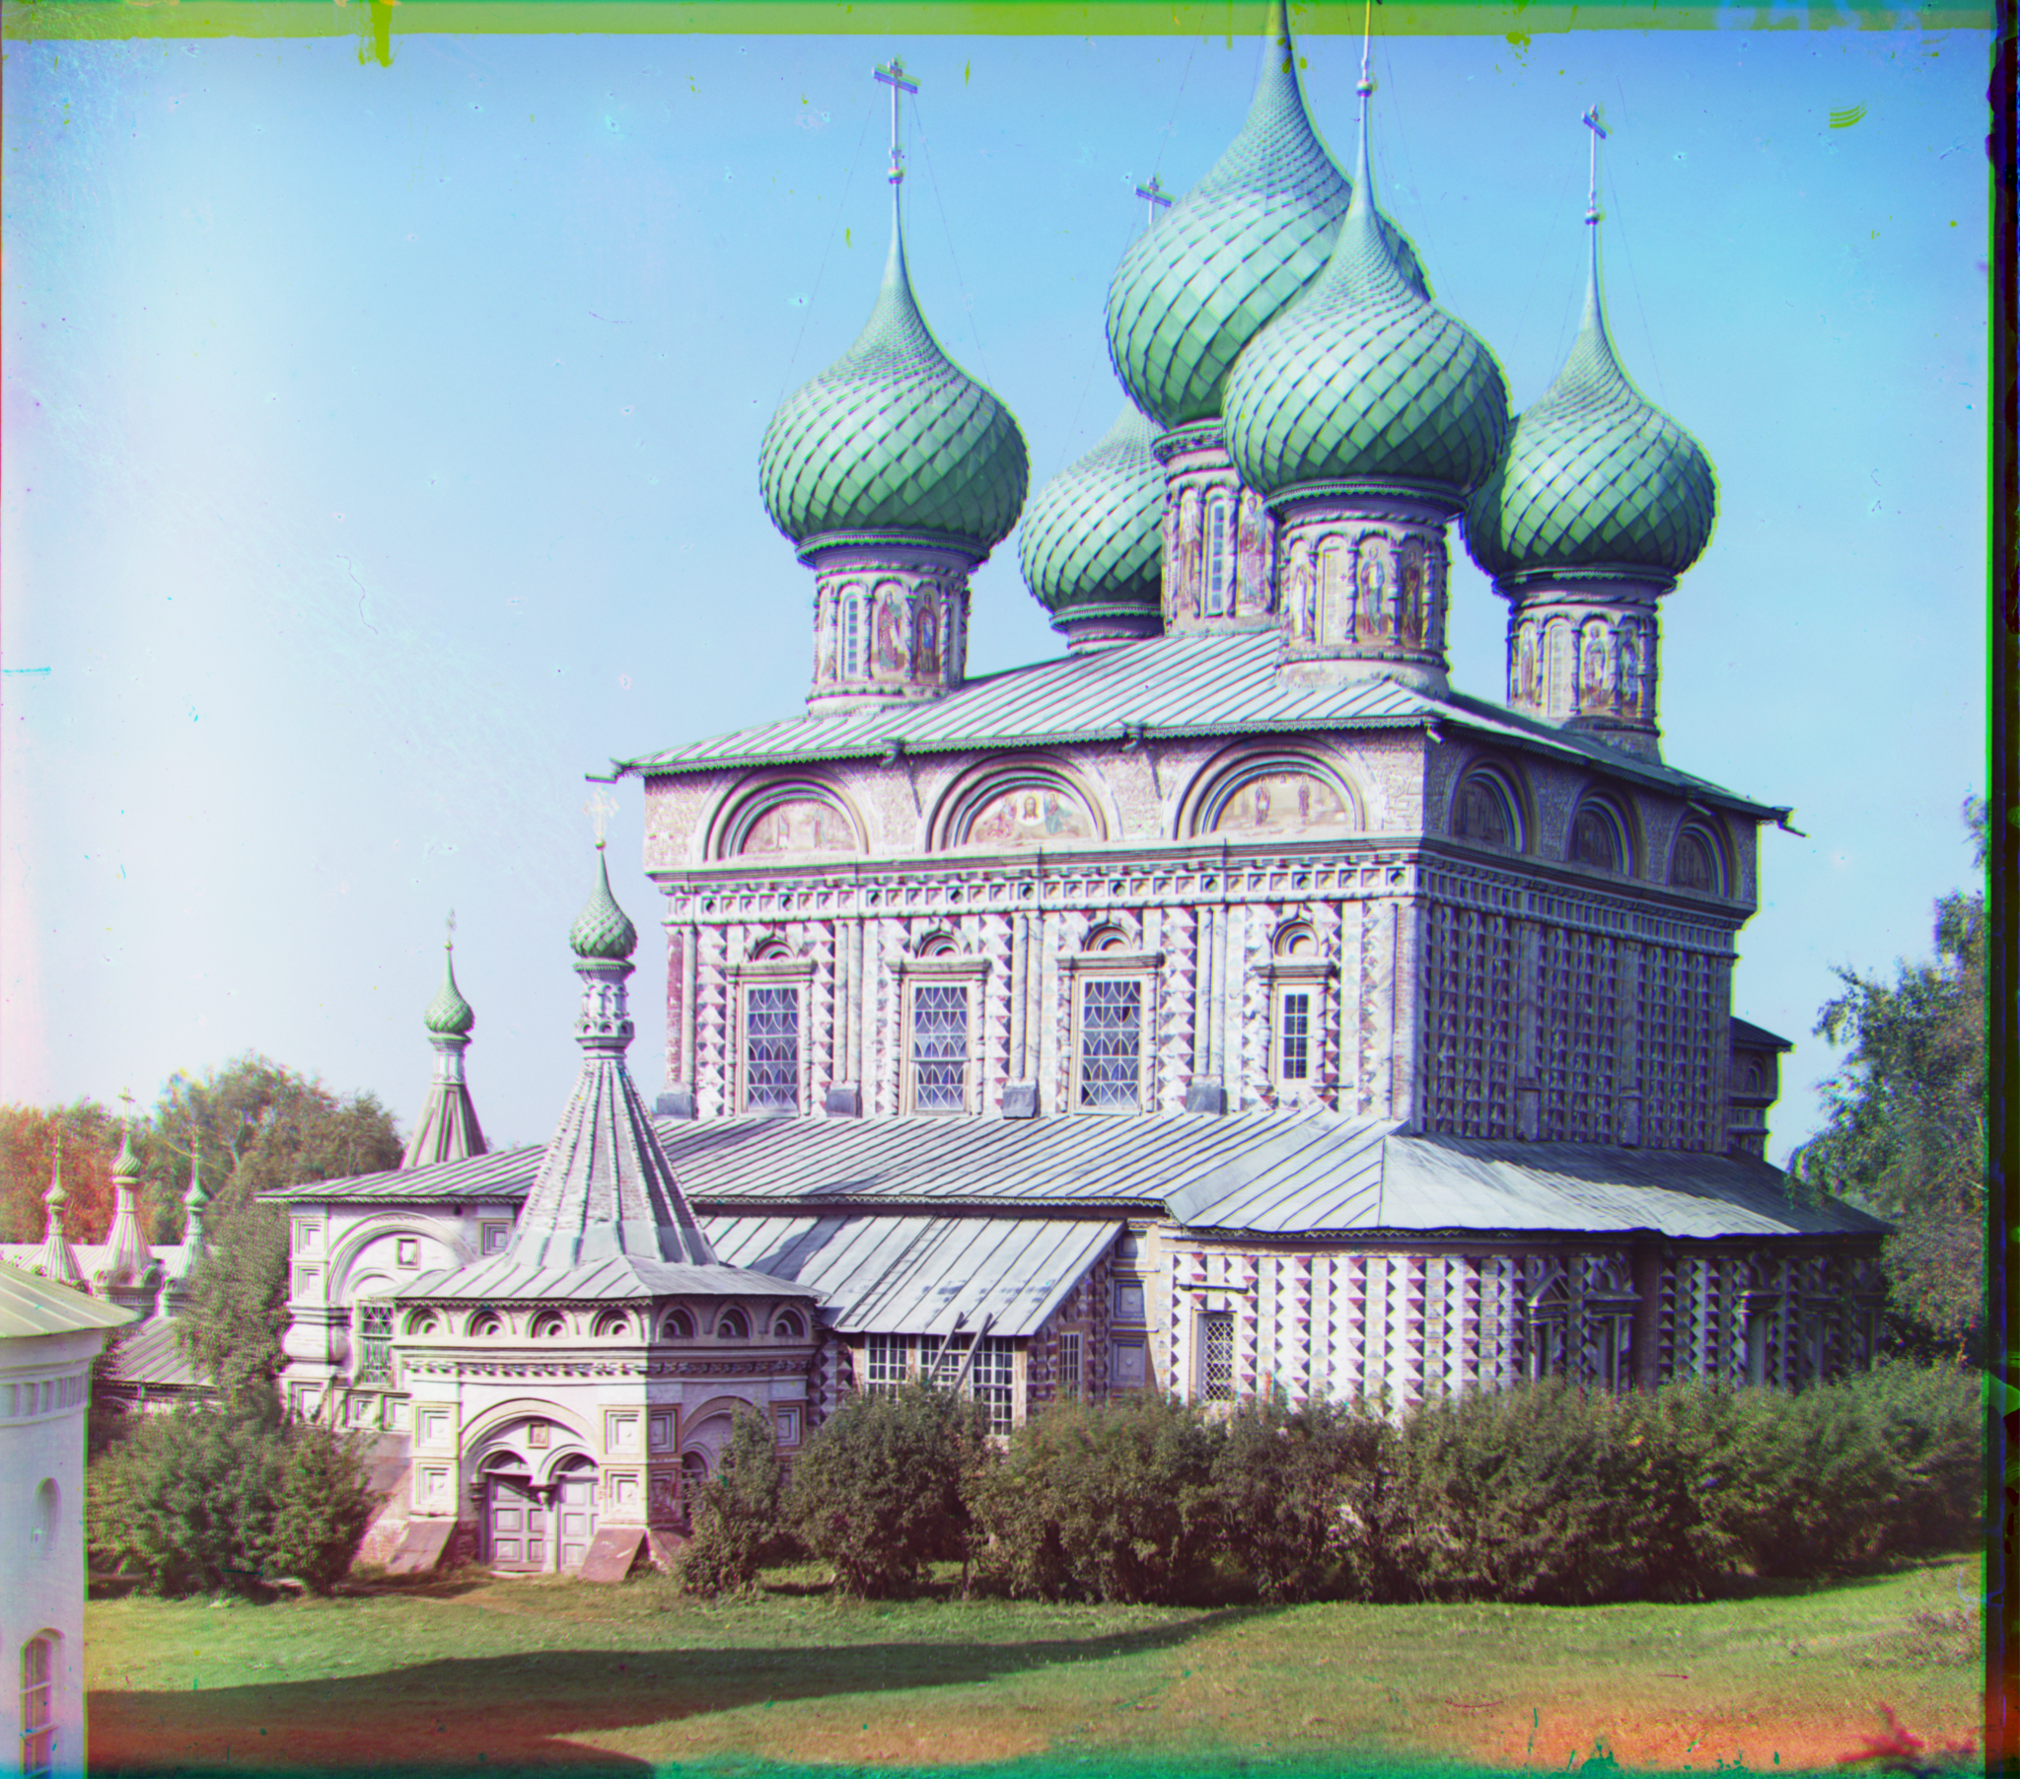
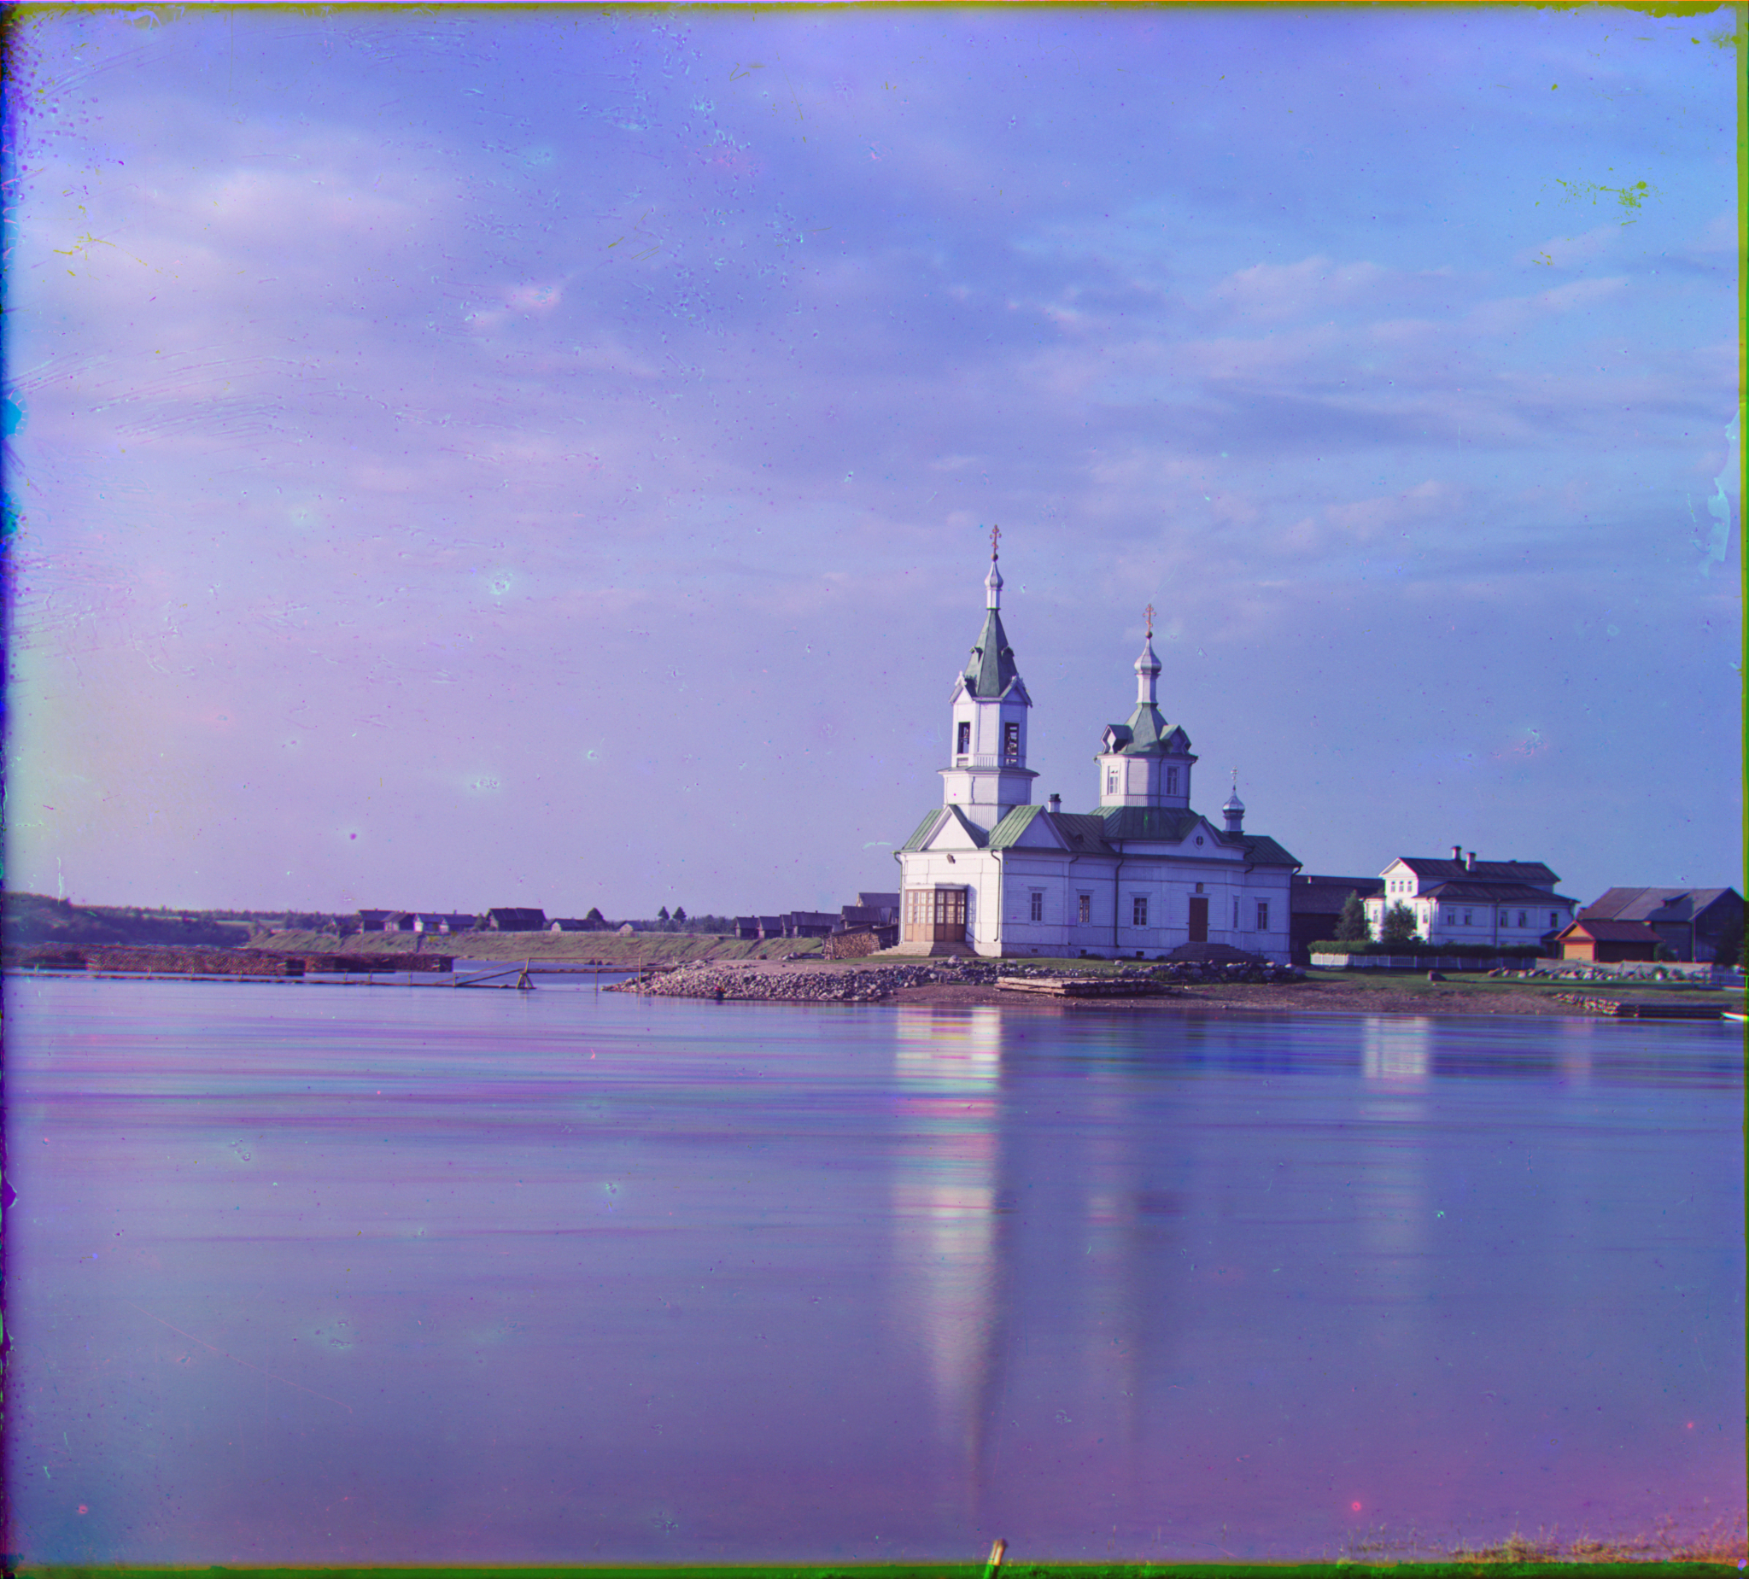
Result

Slide 26
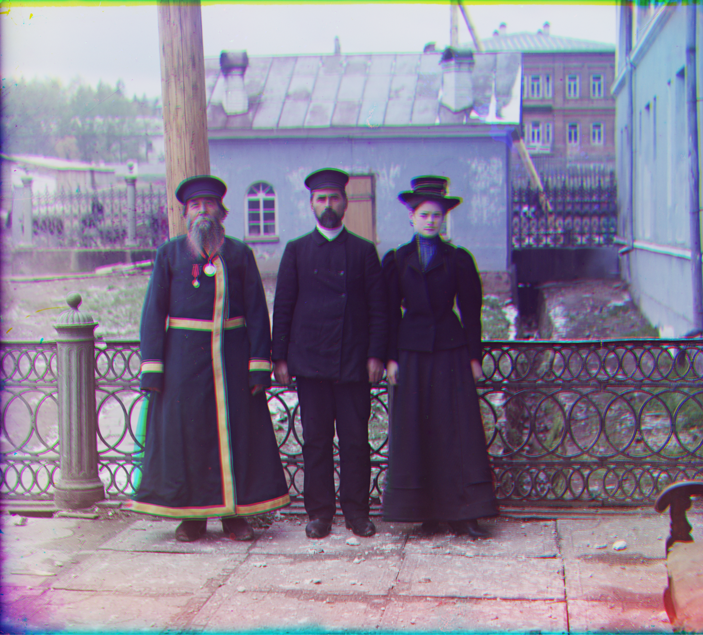
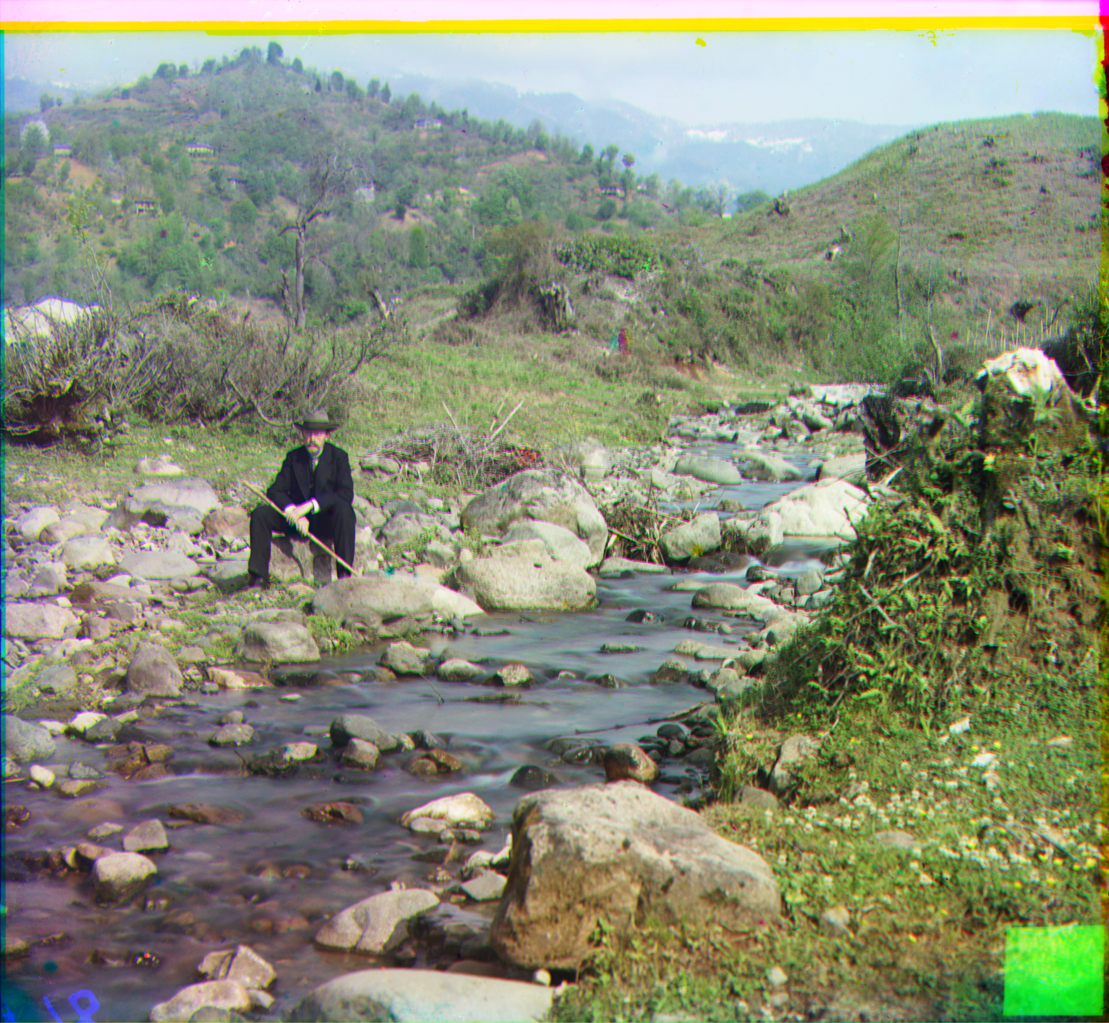
Result

Slide 27
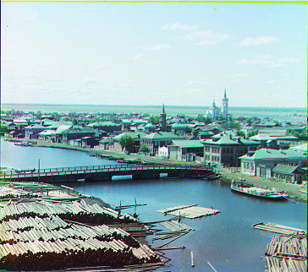
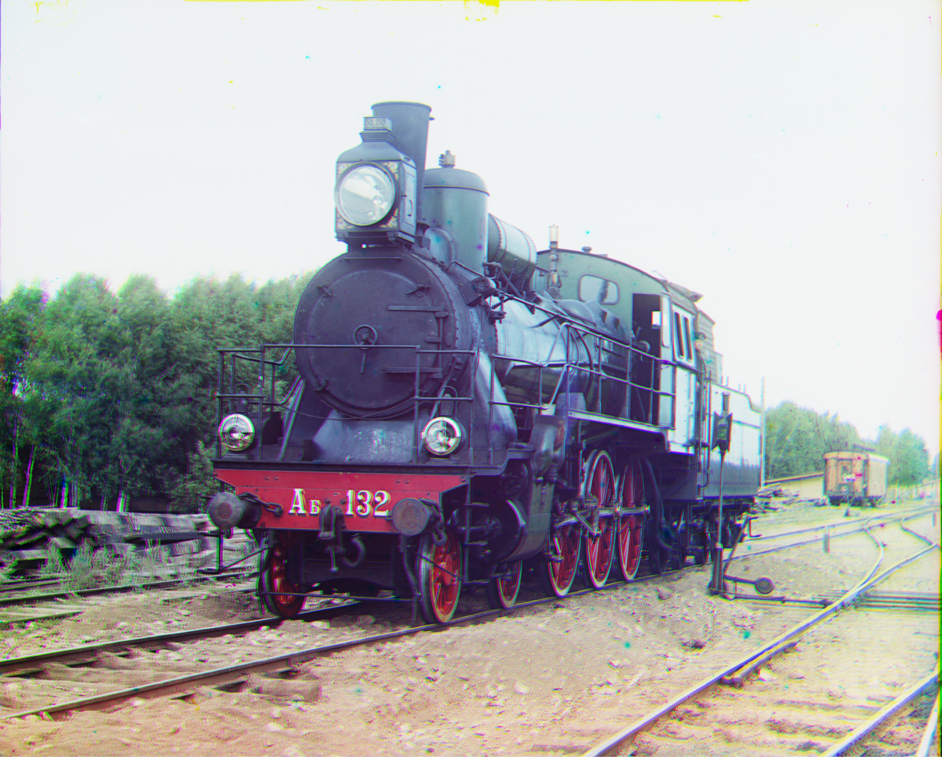
Result

